Slide 1
License Manager Basics 5.10

Slide 2
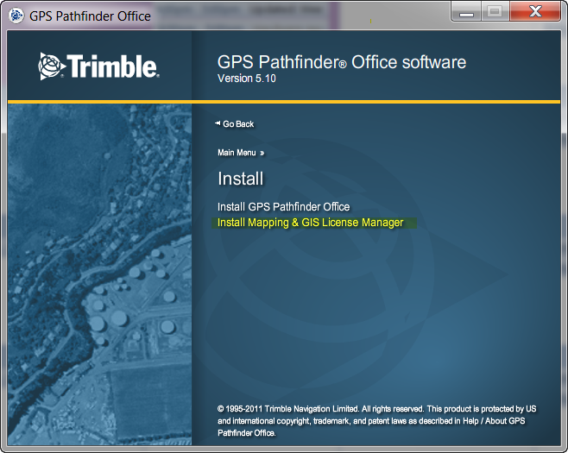
Trimble License Manager
®
From the GPS Pathfinder Office Install CD Image select Install License Manager for installation on your server

Slide 3
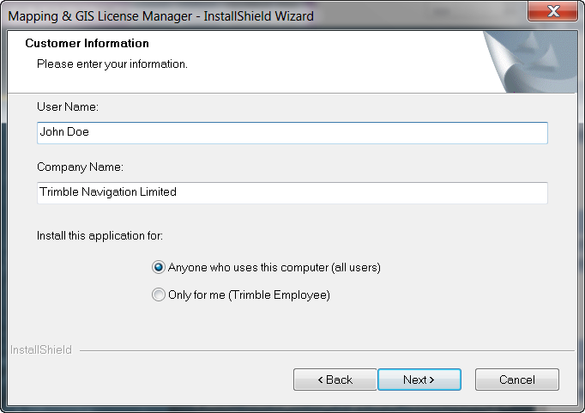
Trimble License Manager
®
Enter Customer information and who will have access to the application

Slide 4
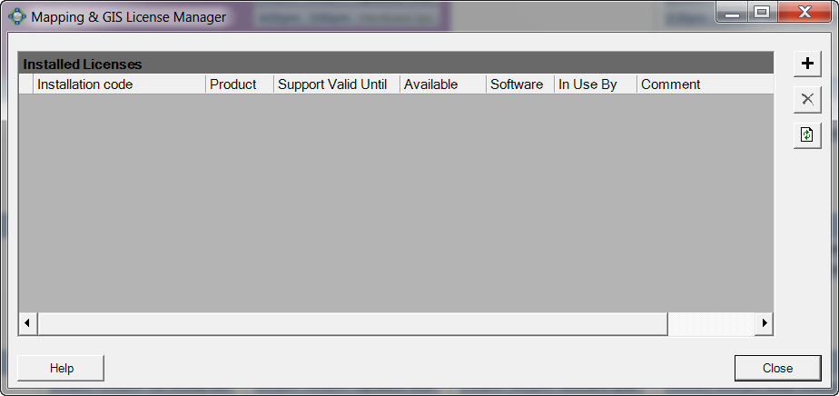
Trimble License Manager
®
Click ‘Next’ until Installation Completes
The License Manager application appears as below
Click the ‘Plus’ button to add installation codes purchased

Slide 5
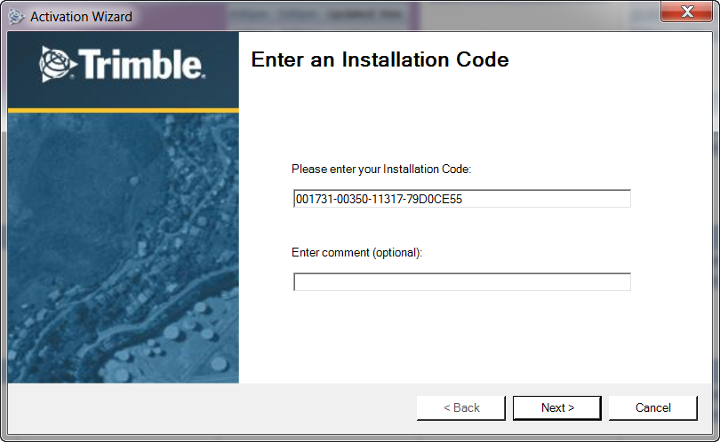
Trimble License Manager
®
Enter your available installation codes and comment if desired

Slide 6
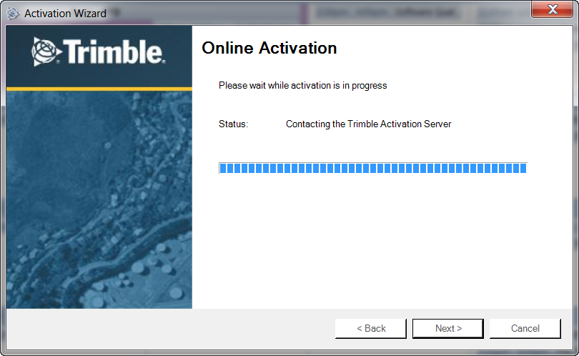
Trimble License Manager
®
Activate the license just installed (this must be done one at a time for as many licenses purchased
Notes:
Trimble is working on an enterprise solution……

Slide 7
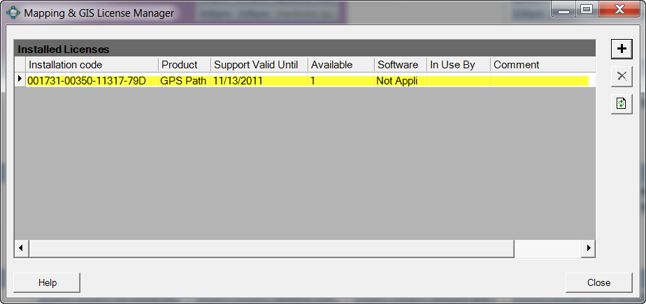
Trimble License Manager
®
The License Manager GUI will list all instances of license codes installed
Notes:
Trimble is working on an enterprise solution……

Slide 8
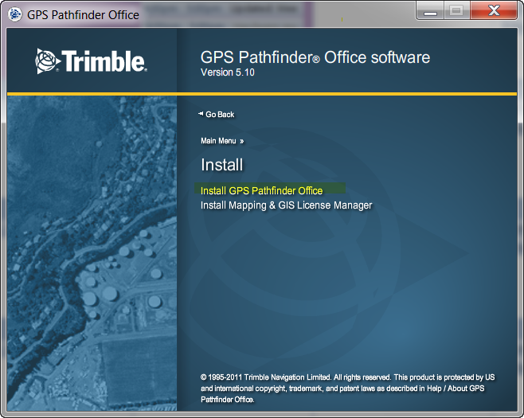
Trimble License Manager
®
Client Machine(s)
Install GPS Pathfinder Office on machines requiring the software from the CD Image executable
Notes:
Trimble is working on an enterprise solution……

Slide 9
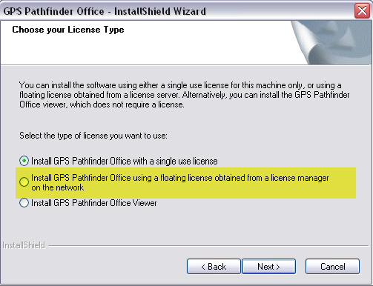
Trimble License Manager
®
Choose the Floating License Option
Enter the network location of the sever where the License Manager was installed (next screen)
Notes:
Trimble is working on an enterprise solution……

Slide 10
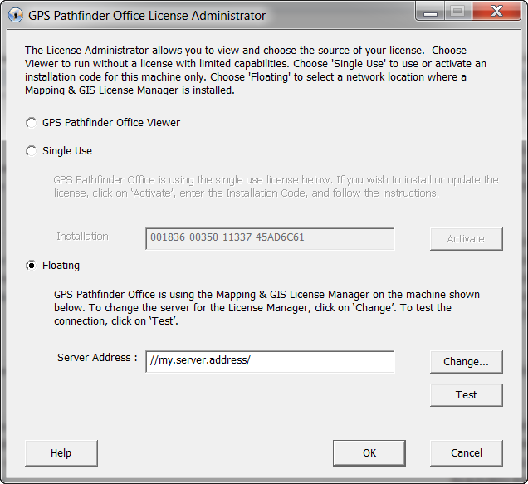
Trimble License Administrator
®
Client Side
The License Administrator allows users to manage how the client machine utilizes an available license install code
Floating License (from server hosting the License Manager)
Viewer Mode
Single Use
Notes:
Trimble is working on an enterprise solution……

Slide 11
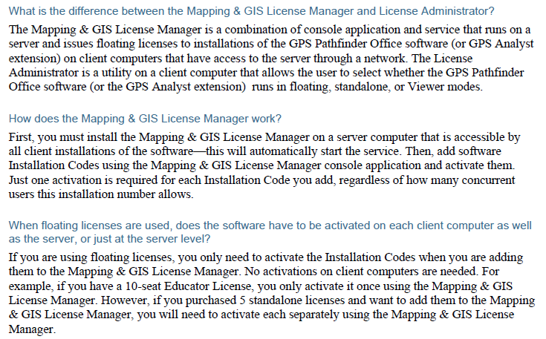
Trimble License Manager
®
See the Support Documentation regarding frequently asked questions and greater application details.
http://trl.trimble.com/docushare/dsweb/Get/Document-545109/SprtNote_PFO_GPSAnalyst_Licensing&Activation_0311.pdf
Highlights:
Notes:
Trimble is working on an enterprise solution……

